Slide 1
Noumena, Phenomena, Intuition and Epistemology

Slide 2

Phenomena & Noumena
Notes:
This terminology is from Kant. How do we know that the phenomenon is in any way an accurate representation of the noumenon?

Slide 3


7d
Notes:
What I want you to see is that the mind (struggles to) create some plausible phenomenon even out of noumenal nonsense.

Slide 4
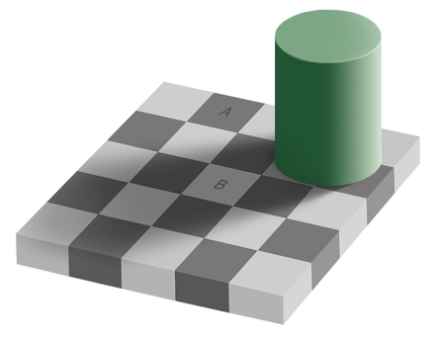

Slide 5
https://en.wikipedia.org/wiki/File:Spinning_Dancer.gif
https://youtu.be/rb1CZfUumDI?t=15
https://www.youtube.com/watch?v=I8Bwzkz50BI?t=13

Slide 6
Bertrand Russell on Naïve Realism
Naïve realism leads to physics.
Physics leads to the rejection of naïve realism.
So if naïve realism is true, it’s false.
Notes:
This mignt seem trivial. I actually want to say a good deal more than this.

Slide 7
Conclusions
We do not know the noumena!
The mind creates images of the noumena! We call them “phenomena” by which we think we experience the noumena. These images are consistent with and limited by the structures, functions, and capabilities of the mind. I call the conceptual aspects of these basic human structures or functions “intuitions.”
These intuitions are built by mental capacities that have evolved. They are simplifications of noumenal realities (twice removed), suitable for survival (i.e. – useful but simple – not expensive), and are intersubjective (not universal) since those of us who discuss them are of the same species.
This Naïve Realism is inadequate! This widespread, common sense, epistemology (Things are as they appear to be, i.e. – as I intuitively conceive them to be) is highly misleading. We are constantly finding flaws with it and trying to improve on it or use it to deceive someone else.
Notes:
The inadequacy is not for survival, but for accuracy in grasping the noumena. Donald Hoffman shows experimental data indicating that evolution doesn’t favor accuracy but quick tricks and hacks. There is a lot of data that moves from the eyes to the thalamus, but there is six time as much from the brain’s visual centers to the thalamus.

Slide 8
Conclusions (continued)
Absolute proof about the noumena doesn’t exist! Proof is contingent on fundamental assumptions. As we replace assumptions with other assumptions which we find “better,” we find that what we thought obvious has become false (or an approximation at best).
What we actually do is to “choose” a paradigm which has been created by us or adopted or adapted from opinions held by others. The “choice” is sometimes unconscious or coerced but is nonetheless a choice. We don’t all make the same choice which is one source of so much discord.
We Each build a network of concepts. Evidence contrary to any given piece of that network can be added to the network by adjusting other parts of the network. Or perhaps we change the paradigm.
Notes:
#5. Buddha – You will be happier if you don’t strive for what you can’t have. Zen saying – All affirmations are false. Kant – Knowledge of the Noumena is impossible. Einstein – We must always be ready to change our axioms. There is no final physics. Kuhn

Slide 9
Four Episodes
Early Buddhism
Immanuel Kant’s Copernican Revolution of the mind
Albert Einstein’s Relativity theory
Cognitive Science
Notes:
Argument by example.

Slide 10
Disclaimers
My primary interest is Epistemology.
I am not trying to argue that views expressed in these episodes are correct; but that they exemplify good practice in epistemology.
These four episodes are selected because they had an impact on me personally. There are thousands of other choices that could have been used.
I am not taking time to give a full exposition of these episodes, but you can ask questions.
Notes:
I am not even saying that my interpretation of these episodes is the correct one. (There are as many understandings of Buddhism as there are Buddhists; There are numerous interpretations of Kant; the literature on Einstein is enormous and varied; and … what can I say about cognitive science?) This just demonstrates my conclusions (especially points 1,2,5,6,&7). My own developing understanding of these episodes also illustrates these conclusions. And I dare say you have probably experienced the same. These conclusions describe our own mental development and apply to themselves.

Slide 11
Over 2500 years ago in India there were numerous schools of thought about what was real or important.
Carvakas
  Perception (empiricism) is the only sure source of knowledge.
  Moksha, afterlife, reincarnation, samsara, karma and religious rites and texts were all rejected.
  Mater only is real.
  Hedonism is recommended.
Jains
  Souls and matter are real. Souls are tainted with karma matter which obscures truth.
  By ascetic practices one could purify the soul and realize the truth.
Orthodox Hindus
  Non-dualism meant that behind atman (self) there was Atman and behind the noumena of the world there was Brahman and Atman = Braman.
Notes:
Notice the difference between Noumena and Phenomena in these schools. Six schools of sramana tradition (including Ajivikas – like Carvakas – only matter continues, all else is annihilated.) Eternalists. Agnostics.

Slide 12

Advaita (Brahman = Atman)
Notes:
According to the Vedas, behind (within, transcendent, imminent in) all things is Brahman. Behind all atmans is Atman. This is metaphysical nondualism but it has huge epistemological implications. Buddha rejects the Brahman and Atman (obviously mental constructs, therefore phenomenal). But he keeps the phenomenal vs. noumenal.

Slide 13

Siddhartha Gautama (Buddha) is best seen as a doctor.
All conditioned existence is dukkha.
Ignorance and craving lead to dukkha.
We can cause dukkha to cease.
There is a path to the cessation of dukkha.
Notes:
In the case of Buddhism the problem is dukkha or the inability to enjoy life. The source of the problem is ignorance and craving, i.e. – mistaken mentation. The solution involves right conception and right thought and right meditation (plus right action, etc.). This includes recognition of the impermanence of everything including space and time and the emptiness of concepts such as self, indeed of all concepts.

Slide 14



Slide 15
Buddha’s Philosophy
Buddha took a middle way between hedonism and asceticism.
Everything is in process, a rapidly changing confluence of elements from the five skandhas.
  Forms, feelings, perceptions, volitions, & consciousness
He stressed the impermanence of everything and thus the non-existence of the soul or self.
We tend to make nouns of these transitory compilations of elements from the skandhas. This is misleading. It leads to misplaced desires and thus to dukkha.
Space and time are co-dependent, (i.e. – do not exist independently of everything else.
Refusing to be mislead will break the chain and lead to the cessation of dukkha.
Notes:
3 things we are ignorant of: Dukkha, Impermanence & non-self. Impermance might also rule out God.
Note the 5 skandhas are all mental phenomena. So clearly we are dealing here with phenomena not noumena.

Slide 16
Conventional and ultimate truth
Truth comes on two levels:
  Conventional, phenomenal, relative, manifold
  Ultimate, real, absolute, one
Nagarjuna points out that all these are empty.
The point is not to take either too seriously.
Buddhism is epistemologically the middle path.
  Not, monism or dualism, but non-dualism
  Illustration with the concept “Self”
  Second illustration: Shuzan’s short staff
Notes:
Detachment. Shuzan held out his short staff and said: “If you call this a short staff you oppose its reality. If you do not call it a short staff, you ignore the fact. Now what do you wish to call this?” (see “Nothing Exists” ZFZB, p.69 - Zen master Dokuon)

Slide 17
Advaya - Non-duality of conventional and ultimate truth
"Advaya" is a non-essentialist, epistemological approach,^{[14]} which questions what we can know about reality. It states that there is no absolute, transcendent reality beyond our everyday reality. It also denies the existence of inherently existing "things" or "essences": nothing has an inherent "essence." According to this definition or usage, nonduality refers to the nonduality between absolute and relative. It is the recognition that ultimately every"thing" is devoid of an everlasting and independent "essence", and that this emptiness does not constitute an "absolute" reality in itself.^{[note 4]}. It is a non-essentialist, or non-absolutist, position, denying any "transcendent" reality.
It is exemplified by Madhyamaka Buddhism, and its insight into the "emptiness", or non-existence, of inherently existing "things",^{[15]} and the "emptiness of emptiness": emptiness does not in itself contitute an absolute reality.^{[note 5]} It is the Middle Way between eternalism ("things" have an inherent essence) and annihilationism or nihilism (nothing exists).[
Notes:
From Wikipedia “Nondualism”
Nothing you can say about the weather in Texas is reliable.

Slide 18
Advaya
Notes:
When we sense something, a cow, a tree, a rock, we mentally construct it with an essence, a cow essence, a tree essence, a rock essence. That’s how we choose to perceive it. Phenomenally we give it an essence, a house, a dog, myself. But the Noumenal entities lack these characteristics. Should the noumenal be regarded as one or many? Now consider the question “Does the self exist?” We also assign it an existence status which the noumena does not have. [See 2 truths.] and then we need to get beyond both of those and see the usefulness of both. Then Ignorance ends, craving ceases and so does dukkha.

Slide 19


Slide 20
Nagarjuna’s 4 or 5 value logic
-A & - B
A &
B
A
B
Notes:
Illustration of tetralemma

Slide 21
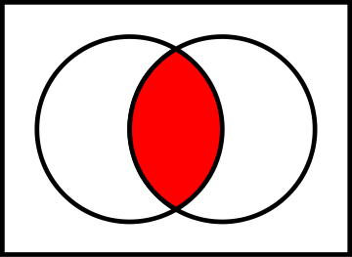
Nagarjuna’s 4 or 5 Value Logic
-A & -B
A & B
B
A
Notes:
The point is to present all logical possibilities, and argue against them all. Then one is left with the insight that the concepts are inadequate.
When we see something, a cow, a tree, a rock, etc., we assign it an essence in our phenomenological construction. But the noumenal does not have these essences. We also assign it an existence status which the noumena does not have. [See 2 truths.] and then we need to get beyond both of those and see the usefulness of both.

Slide 22
Later schools of Buddhism
Representationalists
Mind only school
Space and time are co-dependent, (i.e. – do not exist independently of everything else.
Madhyamaka (Nagarjuna) and emptiness
Notes:
Salvation (cessation of dukkha) comes from the realization that we live in a phenomenal and a noumenal world and that these are different.

Slide 23
No God, Space, Time, Ether, or Self
The Chinese monk Xuanzang studied Buddhism in India during the seventh century, staying at Nalanda. There, he studied the Yogacara teachings passed down from Asanga and Vasubandhu and taught to him by the abbot Śīlabhadra. In his comprehensive work Cheng Weishi Lun (Skt. Vijñāptimātratāsiddhi śāstra), Xuanzang refutes the Indian philosophical doctrine of a "Great Lord" (Īśvara) or a Great Brahmā, a self-existent and omnipotent creator deity who is ruler of all existence. “According to one doctrine, there is a great, self-existent deity whose substance is real and who is all-pervading, eternal, and the producer of all phenomena. This doctrine is unreasonable. If something produces something, it is not eternal, the non-eternal is not all-pervading, and what is not all-pervading is not real. If the deity's substance is all-pervading and eternal, it must contain all powers and be able to produce all phenomena everywhere, at all times, and simultaneously. If he produces phenomena when a desire arises, or according to conditions, this contradicts the doctrine of a single cause. Or else, desires and conditions would arise spontaneously since the cause is eternal. Other doctrines claim that there is a great Brahma, a Time, a Space, a Starting Point, a Nature, an Ether, a Self, etc., that is eternal and really exists, is endowed with all powers, and is able to produce all phenomena. We refute all these in the same way we did the concept of the Great Lord.”

Slide 24
Relating this episode to the conclusions
We do not know the noumena!
The mind creates images of the noumena!
These intuitions are built by mental capacities [that have evolved].
This Naïve Realism is inadequate!
Absolute proof about the noumena doesn’t exist!
What we actually do is to “choose” a paradigm.
We each build a network of concepts.
Notes:
Willy-nilly we must and do build paradigns. But don’t attach great importance to them. “All affirmations are false.” “If you meet the Buddha on the road, kill him.” ZFZB p.69. p.124 (Shuzan’s short staff) 6&7 are OK as long as we are open to replace them with something better as needed.
Shuzan’s Short Staff [a Zen koan from Zen Flesh, Zen Bones p. 124]

Slide 25
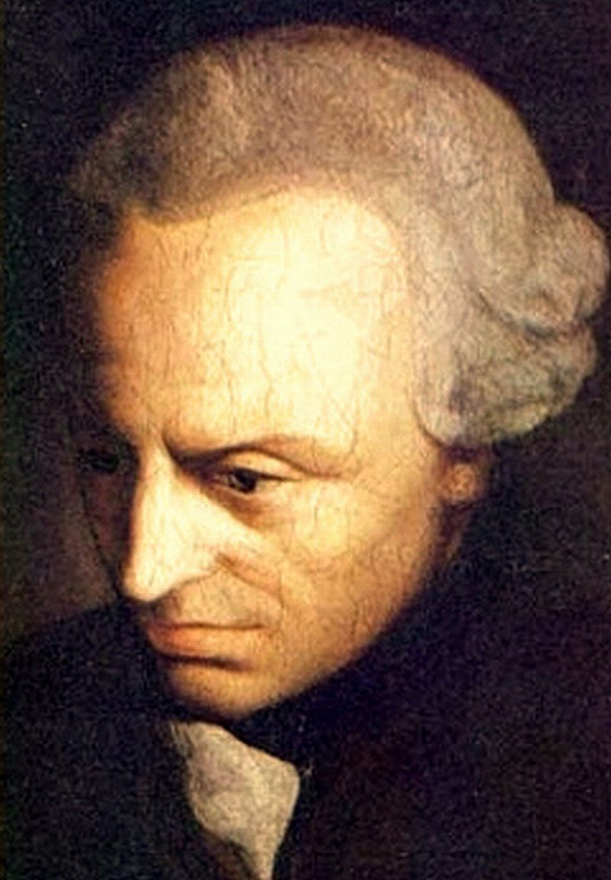
Immanuel Kant was trying to save “knowledge.”
Immanuel Kant’s systematic philosophy can be seen as a synthesis or tombstone of two great traditions or approaches to systematic philosophy.
Notes:
The two traditions are rationalism which had reached a high point with the Greeks and then dominated the philosophy of continental Europe from Descartes to Kant, and empiricism which dominated British philosophy from Locke until they began to understand Kant. By rationalism I refer to that approach to epistemology that gives the key role to reason. By empiricism I refer to that stance that argues that all our knowledge stems from experience and comes through the senses. [An alternative definition of empiricism is the argument that there is no such thing as synthetic – a priori.]

Slide 26
Both of these traditions were in trouble before Kant’s Critique of Pure Reason (1781).
Both were troubled by skeptics.
Neither could give a good account of its own existence.
Rationalism seemed unguided and prone to imaginative constructions such as idealism (even solipsism) and Leibniz’s monads.
Empiricism could not give a reason to think that internal sense data had any relation to external reality or account for our confidence in matter, substance, causation, etc.
More, we could never by empiricism know universals, causation, substance, etc.

Slide 27
Kant’s “Copernican revolution of the mind.”
Kant proposed to approach these problems as a scientist would. When a hypothesis brings up too many problems, we should try a different hypothesis.
Rationalism and empiricism both assumed that we wanted the mind to conform to the “noumena” (a term invented by Kant) or “ding an sich selbst” or “external reality.”
Kant suggested that we should try to see if the “phenomena” (i.e. – our experiences or sensations) would conform to the mind.
If we know what the human mind can and does do, we should know what kind of experiences we might possibly have.
Notes:
If there are certain patterns of experience or mental structures which shape all our experience, then we could build our science on those, because if they always exist we could not experience anything contradictory. Of course this requires a more precise and insightful investigation of mental operations than had ever been done before. And of course not every aspect was done perfectly.

Slide 28
The preface of the Critique of Pure Reason raises three questions:
How is mathematical knowledge possible?
How is scientific knowledge possible?
Is metaphysical knowledge possible?
Notes:
Our lack of knowledge about “God,” “soul,” “afterlife” does not mean that the concepts are useless. There is a role for “regulating ideas.” He had to remove knowledge to make room for faith. These ideas are practically inevitable and should play a role in guiding our actions. But they can cause confusion. They spring from the constitution of our mind.

Slide 29
Kant’s answer to the first two questions is the synthetic-apriori.
Analytic
Synthetic
All bachelors are unmarried.
Every event is caused.
Apriori
All objects are locatable in space.
(relations of ideas)
{None because definitions are contradictory (Predicate contained in subject & only confirmed by experience)}
Aposteriori
That swan is white.
(matters of fact)
Notes:
Marks of the synthetic a priori are necessity and universality. When we find the synthetic – a priori we will know what must be true of all human experience. Because that is how our minds are constructed. E.g. – Newton’s laws of motion can be derived from what is transcendental. Hume said all knowledge claims are of 2 types. Crusius (and Leibniz) speak of Truths of reason and contingent truths.

Slide 30
Kant answers the first question in a section entitled the Aesthetic.
One type of contribution of the mind, synthetic – a priori, comes into play whenever we have a sensation.
If we identify the sensation as internal, it is locatable in time. If we identify the sensation as coming from without, it is locatable both in time and space.
Time and space are “forms” of the mind. They are universal and necessary to all our experience and therefore are a priori. These forms which form all our experience are contributed by the mind. We don’t get them from experience we impose them on experience.
We can know that all objects are locatable in space (a synthetic – a priori judgement) because that is the way the human mind represents all experiences of objects.
This does not mean that there is nothing in the noumena that corresponds in some way with our concept of space. After all we just don’t know anything about the noumena. But our experience is formed by our mind to have 3 spatial dimensions whereas some modern physicists tell us that there are ten or eleven dimensions.
Notes:
The Aesthetic deals with sensation and the mental forms which enable it. All mathematical knowledge is derived from these “forms.” The time & space that we know are phenomenal, not noumenal. Consider motion in space and time.

Slide 31
Kant ultimately distinguishes twelve pure concepts of the understanding
1. Categories of Quantity
Unity
Plurality
Totality
2. Categories of Quality
3. Categories of Relation
Reality
Negation
Limitation
Inherence and Subsistence (substance and accident)
Causality and Dependence (cause and effect)
Community (reciprocity between agent and patient)
4. Categories of Modality
Possibility—Impossibility
Existence—Non-existence
Necessity—Contingency
Notes:
Kant draws these from Aristotle’s logic. I.e.– they come from language and logic (as stand-ins for evolution).

Slide 32
Self as Phenomena & Noumena
Notes:
Insofar as the Self is phenomenal it is understood with the categories of understanding and is therefore seen as determined or caused. Our brain is wired up that way. Insofar as the Self is noumenal it is not determined but free. Otherwise morality and the entire legal system would be pointless and impossible. Similarly with God.
Thus we have simultaneously two levels of truth.
These intuitions show up in the moral law also. In so far as one is intelligent enough to understand one feels the force of “The Categorical Imperative.” Also in Aesthetics, we intuitively experience delight and aversion. We are wired up that way.

Slide 33
Relating this episode to the conclusions
We do not know the noumena!
The mind creates images of the noumena!
These intuitions are built by mental capacities [that have evolved].
This Naïve Realism is inadequate!
Absolute proof about the noumena doesn’t exist!
What we actually do is to “choose” a paradigm.
We each build a network of concepts.
Notes:
Kant draws his categories from Aristotle’s logic. I.e.– they come from language and logic (as stand-ins for evolution). Presumably the forms are evident from considerations of mathematics. Inadequacy is demonstrated in the antinomies and paralogisms. Metaphysics illustrates the “choice” of paradigms.

Slide 34
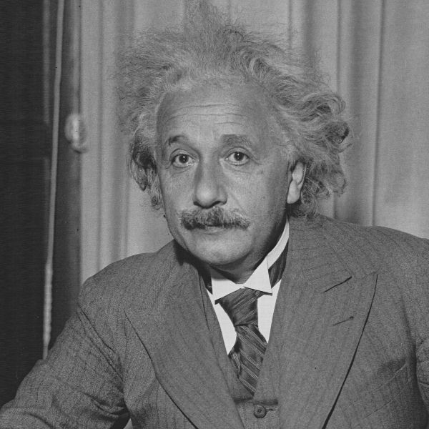
Albert Einstein
The Special Theory of Relativity comes out of an apparent contradiction between the principle of relativity and the electromagnetic phenomena.

Slide 35
Detailing the issue
The principle of relativity says that in the case of inertial systems (moving without rotation or change of velocity) the same general laws of physics apply. [I.e. – if conservation of momentum and energy apply in one system it will in all inertial systems; and relative velocities should add or subtract in all such systems.]
Suppose I travel at lightspeed along with a beam of light. What will I see? My first intuitive guess is a peculiar type of standing wave.
But light moves with the same speed (thru “empty space”) for all systems regardless of the motions of the emitter and receiver.
The first intuitive guess might make sense if “empty space” was filled with some sort of “aether” which transmitted electromagnetic waves.
But all efforts to measure our speed in the “aether” failed and it was not easy to conceive the mechanics of our motion through the “aether” while not disrupting its ability to transmit light.
Notes:
Maxwell’s equations

Slide 36
The source of the problem stems from two inadequate intuitive concepts.
We “borrowed two unjustifiable hypotheses from classical mechanics: these are as follows:
  (1) The time interval (time) between two events is independent of the condition of motion of the body of reference.
  (2) The space interval (space) between two events is independent of the condition of motion of the body of reference.
If we drop these hypotheses, then the dilemma … disappears….” [Relativity, p.30]
Notes:
Time and space are dependent on the observer. They are not objective (meaning the measurements, clocks & meter sticks, depend on relative motion).

Slide 37
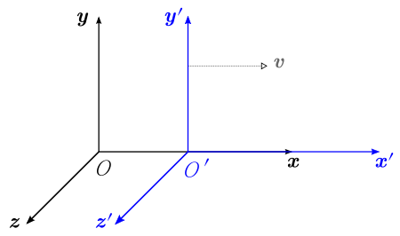
Lorentz Transforms
x - vt
x’ =
2
v
1 -
2
c
y’ = y
z’ = z
v
x
t -
2
t’ =
c
2
v
1 -
2
c
Notes:
Your concept of time contributes to my “space” and your concept of space contributes to my “time.” Minkowski & 4-dimensional space-time. But the “independent” concepts of space & time didn’t disappear. (Why not?)

Slide 38
Hermann Minkowski, 1907
The views of space and time which I wish to lay before you have sprung from the soil of experimental physics, and therein lies their strength. They are radical. Henceforth space by itself, and time by itself, are doomed to fade away into mere shadows, and only a kind of union of the two will preserve an independent reality.
Notes:
Why has this not happened? Because the notions of space and time are intuitions built into the brain as formative of all our experience.

Slide 39
Two Useful Quotes
[The practicing scientist] will… be grateful to the historian if the latter can convincingly correct such views of purely intuitive origin.
  Einstein’s intro to Max Jammer’s Concepts of Space
To Understand a subject one must tear it apart and reconstruct it in a form intellectually satisfying to oneself, and that (in the view of the differences in individual minds) is likely to be different from the original form. This new synthesis is of course not an individual effort; … but for it one must in the end take individual responsibility. – J.L. Synge, Relativity (1956)
Notes:
Putting together many Einstein comments I conclude that Einstein (like Synge) was saying that to understand the phenomena is more than to experience them. One must relate the phenomena to some theoretical system which in some way explained why or how those phenomena have the nature that they have and how those phenomena may appear in the future. The first approximation is on the basis of primitive intuitions. Newtonian mechanics is an improvement on this which utilizes forces, velocities, accelerations collisions and motion thru space and time. But we see it to be inadequate. Better is Special Rel. where Vectors vary with reference frames, but the laws of nature can still be uniform but now expressed in terms of invariables like scalars and dTau. But this still doesn’t account for gravity and accelerating reference frames. To see the laws of nature as constant there one must use more complicated Tensors.

Slide 40
Not just a minor correction at high speeds
“Simultaneity” and “now” are not objective concepts. Neither are space & time.
“Mass” and “energy” are the same. What appears to be matter is only a density in the fields of force. Particles and mechanics are inept concepts. They should be replaced by fields and partial differential equations.
Time on the mountain top passes at a different rate than in the valley.
Hawking and Greene pointed out that Einstein proclaimed that all objects in the universe are always traveling through spacetime at a fixed speed--that of light.
Space and time are warped by the presence of matter.
Space and time can and do expand, stretch, compress, twist, and even get ripped and annihilated.
There are no forces acting at a distance. Gravity is identical to acceleration. It does not depend solely on mass and distance.
Rotating bodies drag space and time into a spiral configuration.
Space and time are actually created by the fields of force.
We cannot apply the concept “before” to the big bang, but we want to anyway. Logic be damned.
Notes:
Reference https://www.physicsforums.com/threads/speed-of-light.75111/#post-565681. Some of this comes from the general theory.
Even sequence is not agreed by two correct observers. Of 2 windup watches the running one has more mass.

Slide 41
Quotes from Einstein
The question of the “truth” of the individual geometrical propositions is thus reduced to one of the “truth” of the axioms. Now it has long been known that the last question is … in itself entirely without meaning. [Rel.,p.2]
[A]s far as the propositions of mathematics refer to reality, they are not certain; and as far as they are certain, they do not refer to reality. [Ideas, p.233]
From the latest results of the theory of relativity, it is probable that our three-dimensional space is approximately spherical, that is, that the laws of disposition of rigid bodies in it are not given by Euclidean geometry, but approximately by spherical geometry. [Ideas, p.243]
But the path was thornier than one might suppose, because it demanded the abandonment of Euclidean geometry….The fundamental concepts of the “straight line,” the “plane,” etc., thereby lose their precise significance in physics.
In the general theory of relativity the doctrine of space and time, or kinematics, no longer figures as a fundamental independent of the rest of physics. The geometrical behavior of bodies and the motions of clocks rather depend on gravitational fields, which in their turn are produced by matter. [Ideas, p.231]
It seems that the human mind has first to construct forms independently before we can find them in things. Kepler’s marvelous achievement is a particularly fine example of the truth that knowledge cannot spring from experience alone but only from the comparison of the inventions of the intellect with observed fact. [Ideas, p.266]
The belief in an external world independent of the perceiving subject is the basis of all natural science. Since, however, sense perception only gives information of this external world or of “physical reality” indirectly, we can only grasp the latter by speculative means. It follows from this that our notions of physical reality can never be final. We must always be ready to change these notions – that is to say, the axiomatic basis of physics… [Ideas, p.266]

Slide 42
More Quotes from Einstein
Scientific thought is a development of prescientific thought…. There are two ways of regarding concepts. The first is that of logical analysis…. Concepts can only acquire content when they are connected, however indirectly, with sensible experience. But no logical investigation can reveal this connection; it can only be experienced. And yet it is this connection that determines the cognitive value of systems of concepts. [Ideas,p.276f.]
The theorist … should not be carped at as ‘fanciful”; on the contrary, he should be granted the right to give free reign to his fancy, there is no other way to the goal. [Ibid., p.282]
…of the energy constituting matter ¾ is to be ascribed to the electromagnetic field and ¼ to the gravitational field. [Principle, p.198]
[Without these fields space and time don’t exist.] [Ideas,pp.372-7]
Notes:
“The Problem of Space, Aether, and the Field in Physics” 1934

Slide 43
Relating this episode to the conclusions
We do not know the noumena!
The mind creates images of the noumena!
These intuitions are built by mental capacities that have evolved.
This Naïve Realism is inadequate!
Absolute proof about the noumena doesn’t exist!
What we actually do is to “choose” a paradigm.
We each build a network of concepts.
Notes:
2. Humans come up with “primitive intuitions.”
4. “Primitive intuitions” are inadequate & so we are driven to scientific concepts which are always changing (“evolving”). 6. Primitive, Newtonian, Special Relativity, General Relativity, Unified field theory.
7. Under certain conditions we may face the choice of throwing out our conceptual system or accepting it including a flat out contradiction.

Slide 44
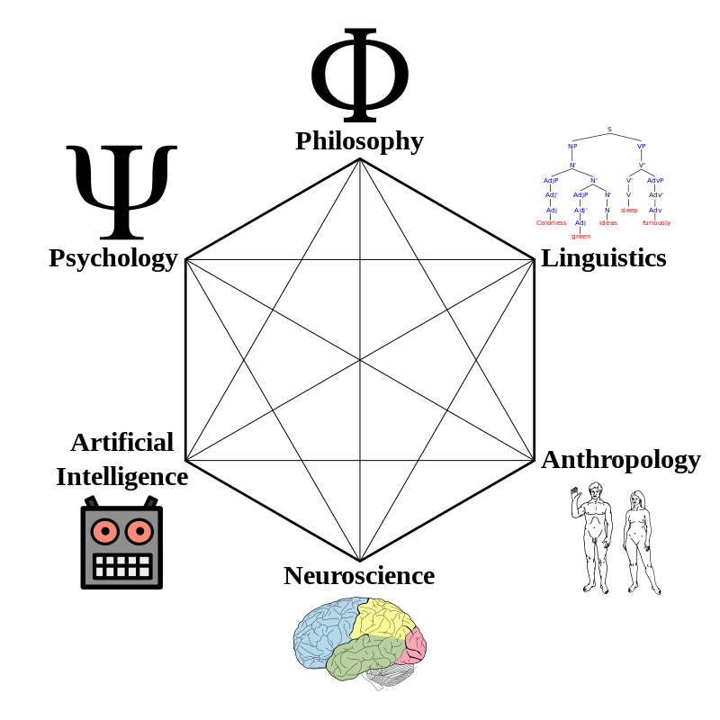
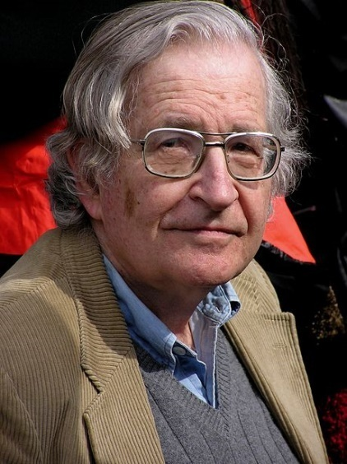
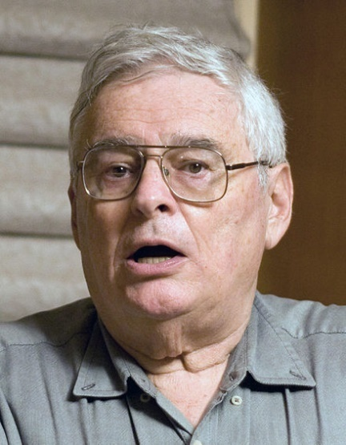



Cognitive Science
How does cognition work and what causes our intuitions?
Chomsky
Fodor
Cosmides
Tooby
Boyer
Barrett
Notes:
Noam Chomsky, Jerry Fodor, Pascal Boyer, Justin Barrett

Slide 45
Historical Beginnings of Cognitive Science
Chomsky played a major role in the decline of behaviorism beginning in 1959 with his review of Skinner’s 1957 book Verbal Behavior. He pointed out that stimulus-response was inadequate to allow learning human languages.
Human beings must have some form of innate linguistic capacity that aids language learners.
In 1983 Fodor published The Modularity of the Mind.
In 1992 Cosmides & Tooby & others came up with “massive modularity.” (cf. The Adaptive Mind)
Notes:
Chomsky coined the phrase “poverty of the stimulus” and postulated a “Universal grammar.” Invisible green ideas sleep furiously.
There is neither enough time, or enough available information, for any given human to learn from scratch to successfully solve all of the problems that we face in the world. This consideration supports the conclusion that the underlying mechanisms we use to solve the relevant problems are innate (for evolutionary psychologists “innate” is usually interchangeable with “product of natural selection”). If we invoke this argument across the whole range of problem sets that humans face and solve, we arrive at a huge set of innate mechanisms that subserve our problem solving abilities, which is another way of saying that we have a massively modular mind.

Slide 46
Characteristics of (Input) Modules
(according to Fodor)
Domain specific
Mandatory operation
Central processing has only limited access
Fast
Informationally encapsulated
Shallow outputs
Associated with fixed neural architecture
Characteristic specific breakdown patterns
Characteristic pace and sequencing of ontogeny

Slide 47
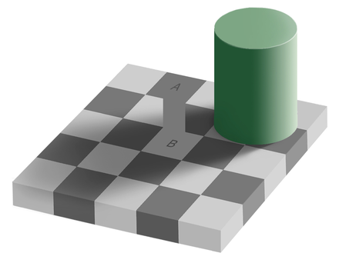

Slide 48
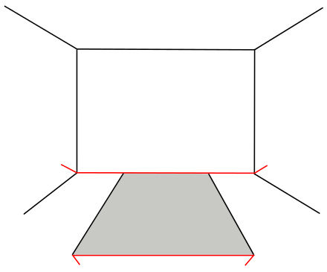
Muller-Lyer illusion

Slide 49







The Modularity of Mind
retina
cochlea
taste buds
olfactory
pressure
---
V1
Auditory Cortext
---
V2
Wernicke A
---
Visual
Linguistic
Central Processing
Memory
Conscious Processing
Motor C
Broca Area
Notes:
Fodor had transducers, input systems (incl. language), and central processing.

Slide 50
Sample List of Modules
Kinship index
Mate selection
Cheater detection
Hyperactive agency detector
Theory of mind
Intuitive physics
Intuitive biology
Intuitive sociology
Intuitive psychology
Thing detector
Artifice detector
Animal detector
Teleological explanation preference
Fairness evaluator
Disgust
Cooperation
Conflict
Other moral bases
Fight
Flight
Food detector
Spatial perception
Temporal perception
Notes:
Also multiple internal clock modules and spatial modules. Recent discovery of neural circuit that prompts one to eat sugar. Face recognition.

Slide 51
Edvard I. Moser, Emilio Kropff, and May-Britt Moser in Annu. Rev. of Neuroscience 2008
In agreement with the general ideas of Kant, place cells and grid cells in the hippocampal and entorhinal cortices may determine how we perceive and remember our position in the environment as well as the events we experience in that environment.
Spatial navigation may become one of the first nonsensory cognitive functions to be understood in reasonable mechanistic detail at the microcircuit level.
Notes:
Rats and humans have a 2-D grid cell array. Bats have a 3-D grid.

Slide 52
Spatial Perception Involves Several Modules
Place cells
Grid cells
Orientation cells
Border cells
Speed cells
Path integration
Combine with memory
Navigate back home or from A to B
Notes:
Matabelli & termites (E.O.Wilson & Steven Pinker)

Slide 53
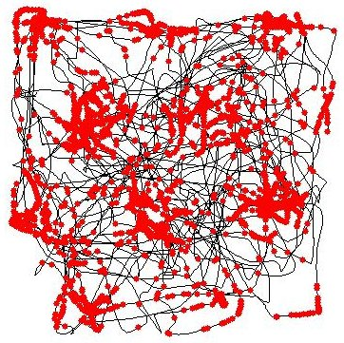
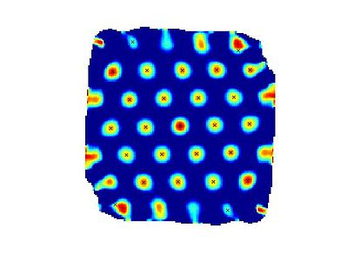

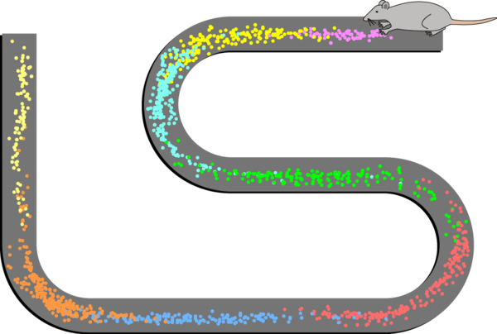

Grid, Place, & Boundary Cells
1
2
3
4
5
6
Notes:
Entorhinal cortex, hippocampal cortex. Notice the grid is flat, not Reimanian. The reason you think space is Euclidian is that your brain is structured to perceive it so. An example of evolutionary shortcut that saves much effort and confusion.

Slide 54
Belief in God is almost inevitable
Caused by action of Hyperactive Agency Detection Device
Boyer and Barrett agree this far.
Boyer then rejects intuitive acceptance of God
Barrett argues that maybe the intuitive acceptance is appropriate.
Notes:
If I came across a mental construct that pushed my wife into loving me, would I say she doesn’t love me? Barrett cites a recent survey that over 90% of humans believe in God, or witches, or some supernatural being.

Slide 55
Relating this episode to the conclusions
We do not know the noumena!
The mind creates images of the noumena!
These intuitions are built by mental modules that have evolved.
This Naïve Realism is inadequate!
Absolute proof about the noumena doesn’t exist!
What we actually do is to “choose” a paradigm.
We each build a network of concepts.
Notes:
Remember the Australian Jewel Bettle (the female is dimpled, glossy and brown). Donald Hoffman’s experiments show that “fitness” is the key to species survival. And accurate perception loses out every time to a good trick. Consider the icon on your computer desktop (blue, rectagular, lower right corner). Does that mean the file is blue, rectangular, in the lower right corner of computer? Similarly our phenomena are like icons, they hide the details of reality while allowing us to interact with reality. Donald suggests 3 theories: 1) what you see is exactly what is [obviously not so], 2) what you see is the result of a giant machine programming your mind [highly doubtful], 3)what you see is the result of a large number of sentient beings influencing each other [currently exploring] {what you see is provided by God}

