Slide 1
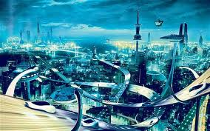
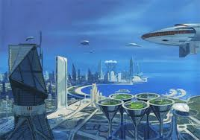
The World in 2034:
Ethical Conundrums, Challenges, and Issues
Dallas Philosophers Forum

Slide 2
Outline
Investigate exponential growth of computer software and hardware
Review technology trends in genetics, nanotechnology, robotics, and AI
Explore ethical implications and challenges of these trends

Slide 3
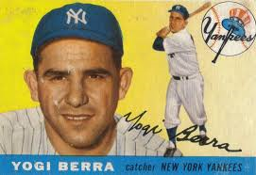
Dangers of Predictions
“It’s tough to make predictions, especially about the future.” --Yogi Berra

Slide 4
Headlines From the Past
“The telephone has too many shortcomings to be seriously considered as a means of communication. The device is inherently of no value to us.” —Western Union internal memo, 1876
“Heavier-than-air flying machines are impossible.”—president of Royal Society in 1895

Slide 5
Headlines From the Past (Cont’d)
“Everything that can be invented has been invented.” --Commissioner of U.S. office of Patents, 1899
“Who the hell wants to hear actors talk?” --Harry Warner, Warner Brothers, 1927
“I think there is a world market for maybe 5 computers.” —Thomas Watson, Chairman of IBM in 1943

Slide 6
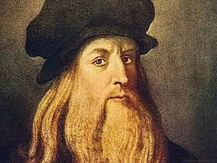
First Futurist (Arguably)

Slide 7
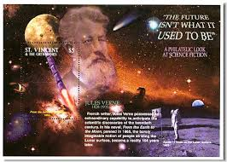
Another Futurist

Slide 8
Technology
“Any sufficiently advanced technology is indistinguishable from magic.” --Arthur C. Clarke
“Technology is anything invented after you were born.” --Alan Kay

Slide 9
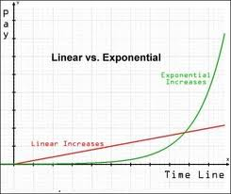
Technology Revolution
Law of accelerating returns:
Linear: 30 steps (1, 2, 3 . . . ) takes us to 30.
Exponential: 30 steps (1, 2, 4, 8 . . .) takes us to ????????????

Slide 10
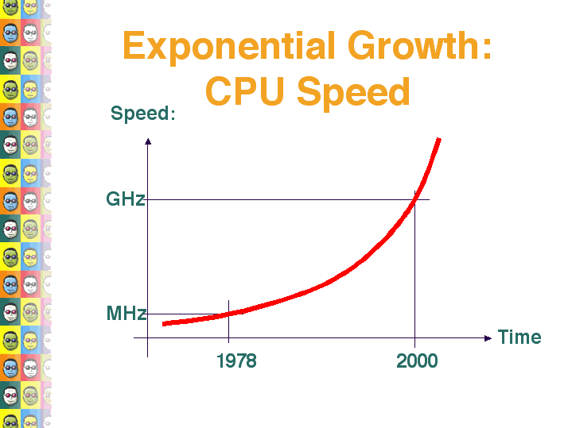
Exponential Growth

Slide 11
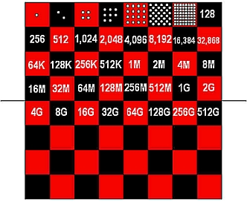
A Story About Chess

Slide 12
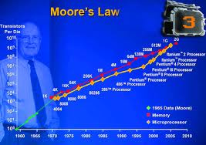
Moore’ Law
Moore’s Law: observation that over the history of computer hardware, the number of transistors of integrated circuits doubles about every 18-24 months

Slide 13
Technology’s Impact
Four Overlapping Revolutions
  Genetics—Human Genome Project
  Nanotechnology
  Robotics
  Artificial Intelligence

Slide 14
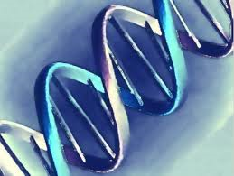
Genetics

Slide 15
What is Genetics?
Genetics is the branch of biology that deals with heredity
It is the scientific study of how genes control the characteristics of plants and animals
Nature versus nurture is an outmoded way of thinking

Slide 16
Genetics (Cont’d)
Human Genome Project—largest collaborative biological project ever--$3B
Exponential Factors Involved—cost of DNA sequencing is plummeting
Personalized Medicine—using person’s DNA map to predict disease and personalize treatment

Slide 17
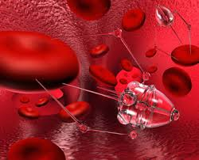
Nanotechnology
“The role of the infinitely small is infinitely large.” --Louis Pasteur—

Slide 18
What is Nanotechnology?
Nanotechnology is the study of manipulating matter on an atomic and molecular scale.
A nanometer is one billionth of a meter, 100,000 times thinner than strand of normal hair
Nanometer and a thimble scenario
There are currently over one thousand manufacturer-identified nanotech products
Nano-materials currently in sunscreen, cosmetics, surface coatings, and some food products

Slide 19
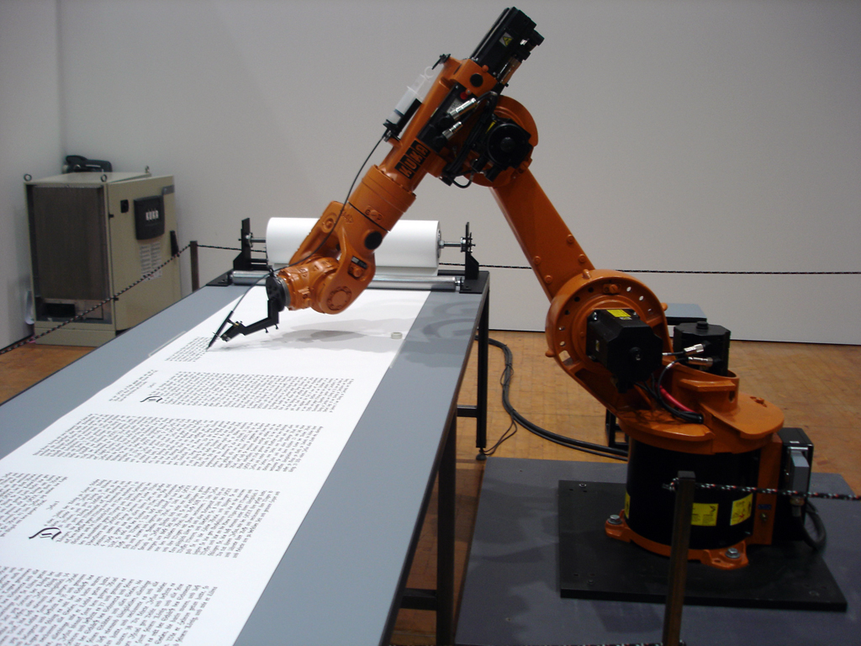
Robotics

Slide 20
What is Robotics?
Robotics is the branch of technology that deals with the design, construction, operation, and application of robots, as well as computer systems for their control, sensory feedback, and information processing.
Can take the place of humans in dangerous environments or manufacturing processes, or resemble humans in appearance.

Slide 21
Weaknesses of Robots
Lack strong AI
Lack intuition
Lack creativity
Lack common sense
Lack pattern recognition
Lack consciousness

Slide 22
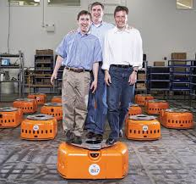
Mini Robots for Warehouses

Slide 23
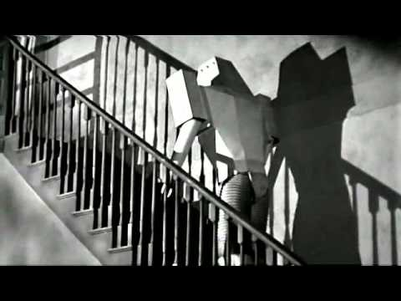
Realistic Possibility—Robots and Man

Slide 24
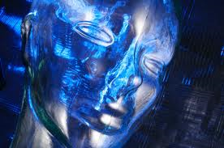
Artificial Intelligence

Slide 25
What is Artificial Intelligence (AI)?
AI is the intelligence of machines and the branch of computer science that aims to create it.
AI textbooks define it as "the study and design of intelligent agents" where an intelligent agent is a system that perceives its environment and takes actions that maximize its chances of success.
Founded in 19__ ?????
Impact on symbol analyst jobs in the future

Slide 26
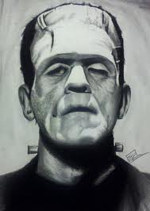
AI Yesterday

Slide 27
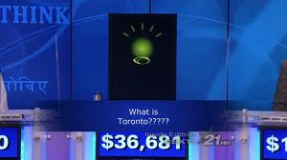
AI Today

Slide 28
Watson
Watson is now going to medical school
Using big data to diagnose and treat patients
Goal: Watson and doctors as collaborators

Slide 29
Questions for AI (or Siri)
What is the depth of the Red Sea? (7,254 feet)
Where is Elvis Buried?
Why did the chicken cross the road?
Can a crocodile play basketball?

Slide 30
Applications of These Four Key Technology Trends
Medicine and Health Care
Transportation
Agriculture
Manufacturing
Housing

Slide 31
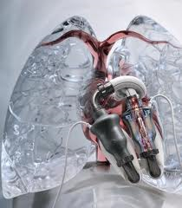
Medicine of the Future

Slide 32
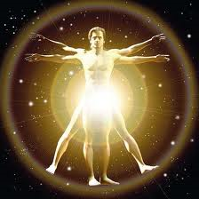
What Will Medicine Look Like in 2034?
Longevity medicine--genetics
Nanobots
Robotic techniques
Artificial intelligence
Neuroprosthetics
P4 Medicine
  Predictive
  Personalized
  Preventive
  Participatory

Slide 33
Medicine: Ethical Issues
  Technology causes costs to rise more rapidly (e.g., robotics in surgery)
  Longevity issues: end of life care
  Ethical and economic implications of boosting lifespans
  Genetics testing—privacy implications

Slide 34
Medicine: Ethical Issues
  “Amped” humans: neural implants for “normal people”
  Homo sapiens: combination of biological and non-biological intelligence
  More catastrophe cases (e.g., smaller premature babies surviving, Ebola)--how to ration health care?
  Over-treatment & over-diagnosis:advanced technology

Slide 35
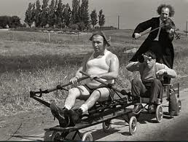
Transportation in 2034

Slide 36
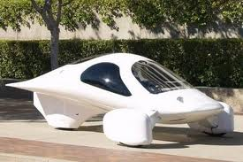
Transportation in 2034

Slide 37
Transportation in 2034
Telematics
Intelligent highways and roads
Vehicle Infrastructure Integration (VII)
Drones—privacy & safety issues
Driverless automobiles and trucks
Way down the road (2090?)—Flying cars

Slide 38
Transportation: Ethical Implications
Reduced auto losses (e.g., reduction in drunk driving, collision avoidance systems, telematics)
Liability for accidents involving autonomous vehicles? Auto manufacturer, developer of autonomous feature, owner of car?
How will this play out based on the capabilities of the driver?
  Disabled drivers
  Elderly

Slide 39
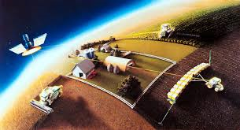
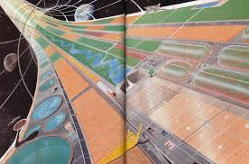
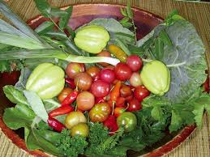
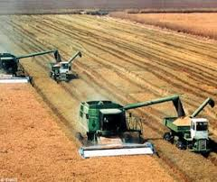
Agriculture in 2034

Slide 40
Agriculture in 2034
Wireless sensors to monitor environmental and soil conditions
Precision Agriculture (less waste)—variable rate technologies
Mega farms (greater environmental exposures)
Cloning technologies
Genetic engineering

Slide 41
Agriculture: Ethical Implications
Genetically Modified Organisms—health implications
Cloning technologies—downsides
Nanotechnology

Slide 42
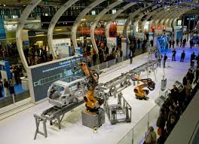
Manufacturing in 2034

Slide 43
Manufacturing in 2034
Robotics and artificial intelligence
Molecular nanotechnology
Individuals transformed into manufacturers through desktop fabricators

Slide 44
Manufacturing: RM and Insurance Implications
Who is responsible if robot causes injury?
Challenges with intellectual property--robots
Rise in robotics—loss of “fingertip knowledge”
Nanotechnology—impact on worker’s health and the environment
Worker and environmental safety versus economic growth and laissez faire capitalism
Nanoparticles—asbestos of the 21st Century?

Slide 45
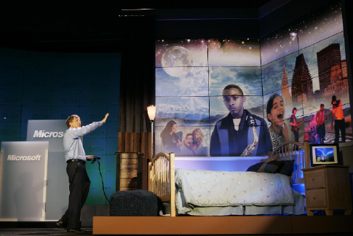
Life at Home in 2034

Slide 46
Housing in 2034
Smart homes
Homes with robots
Homes with monitoring devices
RFID tags for personal property
Green homes

Slide 47
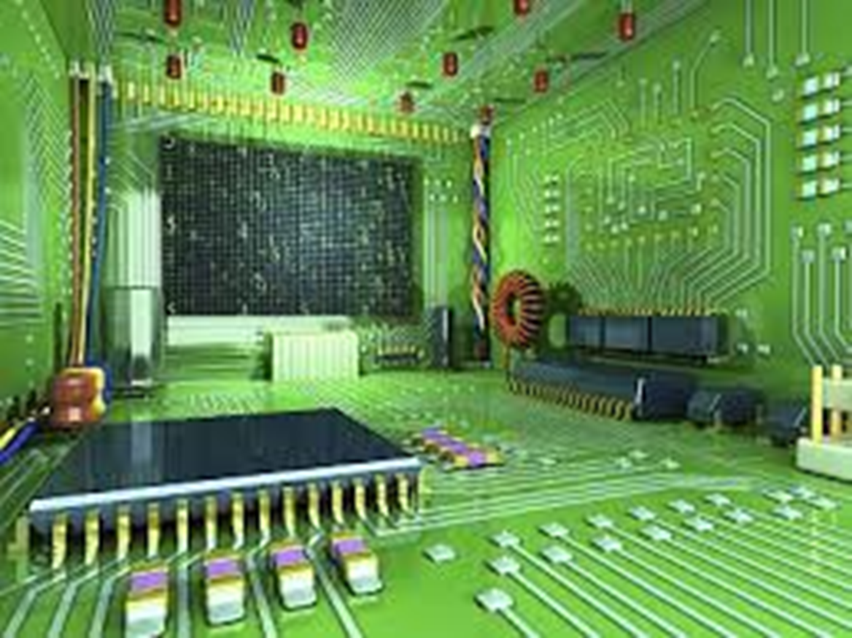
Smart Home

Slide 48
Ethical Implications
Libel via the Internet and Social Media
Problems with Big Data—privacy and dictatorship of data
Prison Math & Big Data—Can it predict criminal risk? Can it deliver fair & equal justice?
Desktop fabricators—intellectual property issues
Do we need to re-think the issue of copyrights and intellectual property?
Desktop fabricators—3D printing of illegal drugs

Slide 49
Economic and Societal Implications
Dangers concerning robots
Digital Divide--technology haves and have- nots—increasing the inequality gap?
Excessive computer monitoring of workers
Computer-assisted arbitrage in stock market fluctuations
Ethical problems--due to rise in technology (e.g., salami slicing)

Slide 50
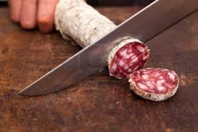
Salami Slicing

Slide 51
Economic and Societal Implications
Loss of blue collar jobs due to stunning growth in technology
Second Machine Age and loss of symbol analyst jobs
Study of IT ethics as a unique field of its own
RoboLaw: Laws & regulations far behind technology

Slide 52
Growth of Robots & AI: Ethical Implications
Transhumanism: Will robotics with strong AI be more capable than humans in the distant future?
Machine learning: Can robots get smarter?
Will robots in the deep future have rights?
Computationalism—is the human mind nothing more than an advanced computer program?
Does this devalue the human brain?
Differences: human brain and a computer?

Slide 53
Conclusion
The world will be shaped by four dynamic technology forces in the next 20 years--genetics, nanotechnology, robotics, and AI.
How will we deal with these inevitable forces?
“The future is clear to me. What I don’t understand is the present.” --Gerhard Kocher
“I never think of the future—it comes soon enough.” --Albert Einstein

Slide 54
Q&A
  Rob Olson, MLIS, CPCU, CRIS, ARM, AAM, ARP
Senior Research Analyst
International Risk Management Institute
Adjunct Professor at SMU
Adjunct Professor at University of North Texas
Rob.O@irmi.com

