Slide 1
Is Capitalism Unstable?

Slide 2
What is the Price of Inequality?
The gains at the top are far less than the loses at the bottom and middle.
Slower growth
Lower GDP
More instability
More Unemployment
Weakened Democracy
Diminished sense of fairness and justice
Questioning of our sense of identity
Notes:
Joseph Stiglitz, The Price of Inequality: How Today’s Divided Society Endangers Our Future. 2012. See sum. P.xxif.

Slide 3
Arguments Favoring Status Quo
There is an equality – efficiency tradeoff!
Inequality is the inevitable consequence of any incentive system adopted to make the economy work.
Any redistribution necessarily attenuates incentives.
What we have is equality of opportunity.
Any government interference will result in diminishing tax revenues thus hurting everyone.
Notes:
Stiglitz, chapt. 3 and 4, esp. pp. 106ff. Every one of these statements is demonstrably false. “Tax cuts for the rich create jobs.” is also false.

Slide 4
What is Capitalism?
Webster defined capitalism as “an economic system characterized by private or corporation ownership of capital goods, by investments that are determined by private decision rather than state control, and by prices, production, and the distribution of goods that are determined in a free market.”
Notes:
1916, copyright 1936. Lionel Robbins in 1935 “economics is a science which studies human behavior as a relationship between ends and scarce means which have alternative uses.”

Slide 5
What is Capitalism?
(from Wikipedia)
Capitalism is defined as a social and economic system where capital assets are mainly owned and controlled by private persons, where labor is purchased for money wages, capital gains accrue to private owners, and the price mechanism is utilized to allocate capital goods between uses.
The extent to which the price mechanism is used, the degree of competitiveness, and government intervention in markets distinguish exact forms of capitalism.
Notes:
Note two changes: Capitalism is now a social system. And government intervention distinguishes types. Italics and underlining are mine.

Slide 6
What is Capitalism?
(from Wikipedia)
There are different variations of capitalism which have different relationships to markets and the state.
  In free-market and Laissez-faire forms of capitalism, markets are utilized most extensively with minimal or no regulation over the pricing mechanism.
  In interventionist and mixed economies, markets continue to play a dominant role but are regulated to some extent by government in order to correct market failures, promote social welfare, conserve natural resources, and fund defense and public safety.
  In state capitalist systems, markets are relied upon the least, with the state relying heavily on state-owned enterprises or indirect economic planning to accumulate capital.
Notes:
Government intervention distinguishes the three types. In 1916 the markets were perfect and couldn’t fail.

Slide 7
Ideal Capitalism
In this view, Property belongs to citizens, not to governments. People should be allowed to keep what they earn.
The profit motive should be allowed free reign.
Regulation and taxation, especially progressive taxation, are illegitimate government interventions and lead to a less efficient market place.
“Government is not the solution; government is the problem!”
Notes:
Of course this can’t be supported by data! This is basically an appeal to a theoretical ethical foundation.

Slide 8
Traditional Capitalism Died
(in the 1920’s and 1930’s)
Russia, China, and East Asia went to Communism.
Central Europe, Italy, Spain, and Japan went to Fascism.
U.S., Scandinavian countries, and British Empire went to the welfare state.
Many emerging countries remained underdeveloped with warlords and dictatorships.
Notes:
If it ever did exist, it does no more. (cf. Jeffry Frieden, Global Capitalism: Its Fall and Rise in the Twentieth Century). See Thurow, Future of Capitalism, Chapt. 9 “Inflation: An Extinct Volcano”.
Capitalism no longer exists in practice, but it still does as an ideal. It is one pole of ideation underlying what is real. It is seen by many as a goal (utopia) to be fervently striven toward by the faithful. But questions arise: Is that goal intrinsically stable or unstable? And Is empirical evidence relevant?

Slide 9
Assumption of Stable Equilibrium
Adam Smith, following Newton and Quesnay,
  Assumed stable equilibria necessary to have a science.
  But Smith knew that government had to be involved to guarantee continuance of capitalism.
Every Econ 101 Course.
  Price is assumed to be stable at the equilibrium where supply = demand. Not permanently fixed; but for any given supply and demand there is one equilibrium price.
  If not, things get messy and we don’t want to talk about that.
So non-stable or situations without equilibrium just didn’t get much attention or interest.
Dynamic Stochastic General Equilibrium models replaced other equilibrium models.
Notes:
Smith thought that the profit motive and the balance of supply and demand would help stabilize capitalism, especially when government watched over it.
DSGE attempted to replace static models and base its models on microeconomic ideas and treat preferences, technology changes, and institutional changes. It has generally been found to be more complicated than it was worth.

Slide 10
Assumption of Stable Equilibrium
For Milton Friedman stability was a matter of keeping the Gov. & the Fed from interfering.
  But then how do you explain the Great Depression.
  The answer was an exogenous shock of mismanagement of the money supply.
Alan Greenspan thought the economic markets were stable and would automatically adjust.
  After the recent melt down he acknowledged the error.
Almost every major contributor to macroeconomics knew that real economies are not stable.
Notes:
Friedman, Capitalism & Freedom, p.78f. Friedman stressed the value of empirical observations. The problem is the use of models that are simple. They need to be simple for Econ 101. If they are not simple they are useless. But simple models start out with stable equilibriums and balanced forces. They don’t reflect realities. Of course if you start out with assumption of stability, you will likely conclude that things are stable. It is built into your assumptions.

Slide 11
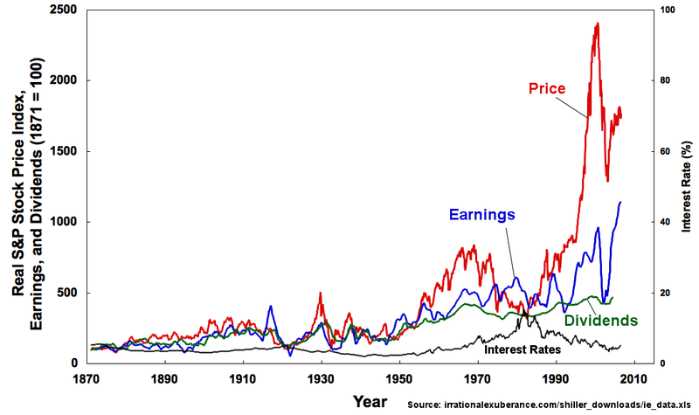
What is Stability?
Diagram from Irrational Exuberance by Robert Shiller, 2005
Notes:
First big drop of red line is the Great Depression market crash.

Slide 12
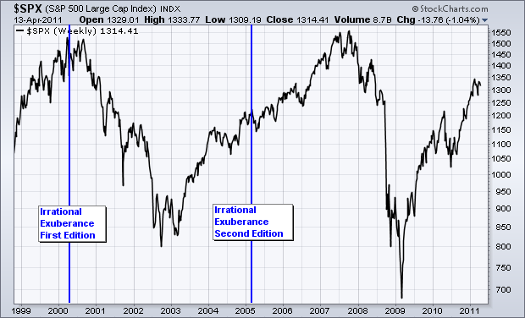
What is Stability?
Diagram from stockcharts.com 2011
Notes:
First blue line is end of previous slide.

Slide 13
So Instability is
The presence of any condition or process which drives some necessary aspect of the economy off a cliff into destruction or into subsidence from which it seems unable to recover.
Any perturbation which causes increasing fluctuations without limit.
Notes:
Not merely a question of infirm or unsteady. E.g. – about 1930 Keynes perceived that, contrary to the expectation of most economists, employment would not of itself recover. The Congo has been stuck in “miserable poverty” for over 500 years. (Why Nations Fail pp. 87-91)

Slide 14
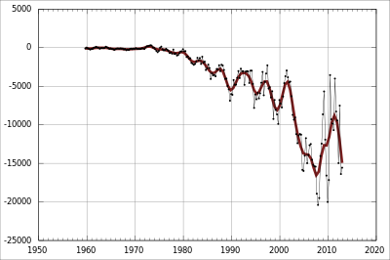
Australian Current Accounts ($A mill.)
Notes:
This illustrates two type of failure.

Slide 15
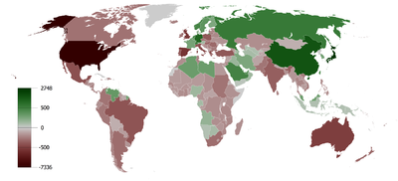
Current Account Debt (1980 – 2008)
Notes:
I want to call attention to two aspects of developmental economics stressed by those who call for austerity. Recent studies on Debt to GDP and the multiplier.

Slide 16
The Debt to GDP Ratio?
Ken Rogoff and Carmen Reinhart published an empirical study titled “Growth in a Time of Debt” in 2010. They found that there was a tipping point when debt reached 90% of GDP. At that point growth tended to become negative, i.e. – countries fall into recession.
However, Thomas Herndon, in a paper for his econometric class, discovered an error in the spreadsheet which cut out 5 relevant countries. Fixing the error changed the growth rate from -0.1 to +2.2% which is about the same as other countries and which totally eliminates the “tipping point.”
Thus a major argument for the austerity approach is eliminated.
Notes:
Obviously the absolute value of debt is not that significant.

Slide 17
How the Multiplier Works
Assuming Propensity to Spend = .8; the Multiplier = 5.
If the Government gives me $100
I spend $80 for groceries.
I save $20 at the bank.
The store mgr. spends $54 for plumbing repairs.
She saves $16.
The Plumber spends $43.20 for shoes.
He saves $10.80.
$34.56…
$8.64
Etc.
Etc.
Totals:
$500
$100
Notes:
I will either save it or spend it. I can’t do both with the same dollar.
So the multiplier multiplies the amount of gov. stimulus or of gov. cuts (as in austerity). Several things cause variation in the multiplier:
Different propensities, Different wealth, different economic conditions. Milton Friedman.

Slide 18

“IMF Chief Economist, Olivier Blanchard and colleague Daniel Leigh, released a working paper that has been seen as an unofficial apology. The paper shows how fiscal multipliers were consistently and severely underestimated in many of the economic growth forecasts of 2010. The underestimation of these multipliers led to projections from economist’s models that also underestimated the potentially negative impacts of austerity measures.”
The new research from the IMF’s chief economist shows that in 2010, most economists failed to see how adverse those austerity measures would be on the European economies that were struggling to get their fiscal house in order. Most forecasters, including those at the IMF, based their estimates on what fiscal multipliers had been in the past, causing them to underestimate the multipliers.
Two years later, the Greek economy is still shrinking and unemployment is at 25 percent.” The fund’s Chief Economist acknowledged the mistake in his paper, finding that the average fiscal multiplier used was .5 when 1.5 was closer to the mark.
A recent econometric analysis by economists Alan Auerbach and Yuriy Gorodnichenko found that fiscal multipliers in the United States fluctuate from near zero in normal times to nearly 2.5 during a recession. In other words, a $1 cut in government spending that would normally have little impact on economic output might result in as much as a $2.50 reduction in total economic output today
Notes:
International Monetary Fund.
These people were concerned about inflation.

Slide 19
Kevin Buchnall’s Synthesis of Classical and Keynesian Economics
AD3 Boom
time
Price Index
SAS is the curved line
AD2
AD1 Depression
LAS
Real GDP
Notes:
If you have ever taken an economics course you have seen supply and demand curves (since Albert Marshall).
At AD3 you want to use classical economics and the multiplier will be low.
At AD1 you want to use Keynesian economics and the multiplier will be higher. (because these workers are struggling to get by).

Slide 20
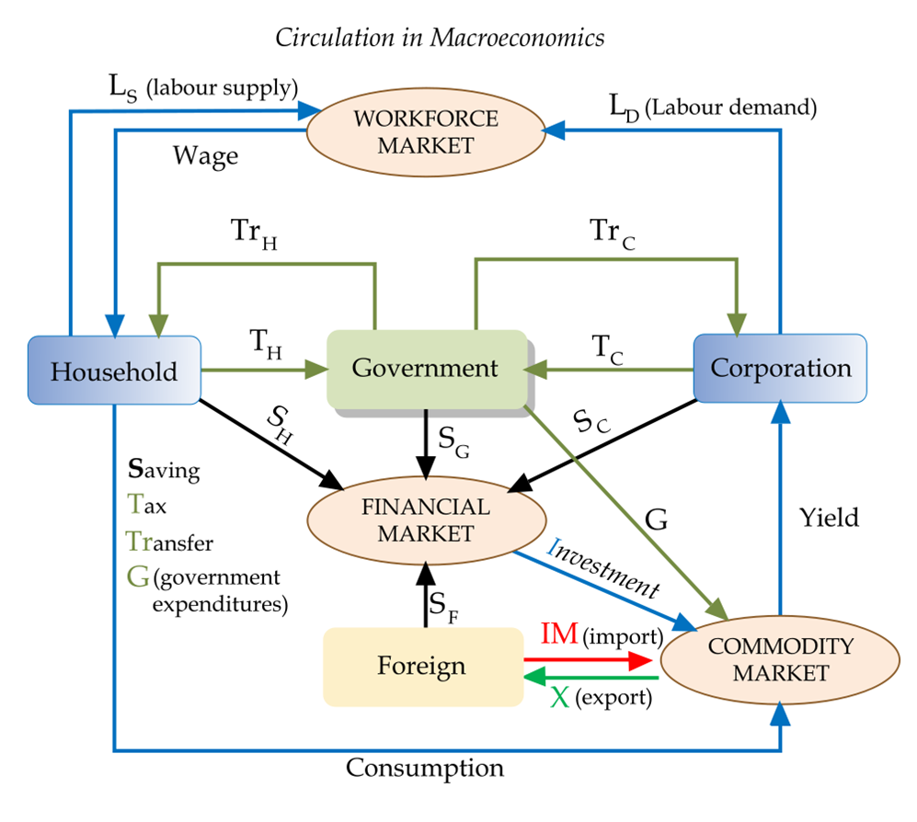
Notes:
1.Minsky’s equations Corp. profit (after tax) = Investment + gov. deficit. 2. Y = C + I + G. 3.If households don’t have money, there is no point in production and more get laid off which means further decrease in production, etc. 4.Further, there is nothing to invest in so financial types have to get inventive to provide something in which the wealthy can invest MBS. Collateralized Debt Obligations, Swaps.

Slide 21
Working Hypotheses
Capitalism generally involves somebody getting out more money than they put in (profit). So capitalism, if successful, is a money pump that increases the disparity between wealthy and poor (unless the poor have money pumps that move money from the rich).
Some of us have acquired very efficient money pumps.
Capitalist extraction by itself is unstable and leads to collapse.
Government, by its transfer payments, has prevented collapse so far. (Twice in the past 80 years we have been on the edge.)
What government does is critical to survival of the system!
This necessity is commonly misunderstood and threatened.
Notes:
Earned income tax credit implemented 1975.

Slide 22
Extractive Politics produce Extractive Economic Systems and vice versa
Extractive political systems exist for the benefit of a narrow elite, and create an extractive economic system. The masses cannot influence the political system, and have no incentives to exert themselves creating wealth that will be taken from them by the political elites. This produces a big gap between rich and poor and two kinds of failure: Collapse and the iron law of oligarchy.
History shapes this cycle. (e.g. Colonial extractionism)
Sustained economic growth requires innovation which involves creative destruction which threatens the dominant elite.
In extractive situations, there is likely to be competition for political power and therefore political & economic instability.
Notes:
The Congo is a classic case. Story of wheel and plow questions. Those who benefit from extractionary institutions tend to sit on innovation and reject creative destruction (e.g. – Russian tsars rejection of railroads, etc.). They defend the status quo. William Lee and Queen Elizabeth, the King of France, and James I. The Ottoman emperor’s law that Muslims are forbidden to use a printing press.

Slide 23
Evidence for Extractionism from
Well known Truisms
The rich get richer and the poor get children.
Money attracts money.
He who has will be given a lot more.
“The forces in a capitalist society, if left unchecked, tend to make the rich richer and the poor poorer.” Jawaharlal Nehru
It takes money to make money.
Notes:
You have to spend money to make money.

Slide 24
Inclusive Politics produce Inclusive Economic Systems and vice versa
Inclusive political systems provide widely utilized incentives for people to acquire skills, work hard, save, invest, and innovate and thereby profit. This requires a strong central government that reflects the interests of many. This tends to produce a more egalitarian and wealthy society.
Inclusive economic institutions enforce property rights, create a level playing field, encourage investments in new technologies and education or training. Innovation and creative destruction are encouraged.
History shapes the institutions of nations.
  The black death forced the collapse of the feudal serfdom in western Europe.
  The growth of Parliamentarianism broadened participation in politics and economics.
  English efforts to extract wealth from North America failed → more egalitarian soc.
But this virtuous cycle is hard to start, rarely successful, and can be corrupted by the growth of extractionism.
Notes:
Acemoglu and Robinson, Why Nations Fail. We don’t have the lobbyist system because it is unsuccessful! Cf Wikipedia “Corporate Welfare”. Even Cato Institute found it to be several times the social welfare and that didn’t include tax loopholes and trade barriers.

Slide 25
More on Extractionism
David Cay Johnston, Free Lunch: How the Wealthiest Americans enrich themselves at Government Expense (and stick you with the bill)
Chrystia Freeland, Plutocrats: The Rise of the New Global Super-Rich and the Fall of Everyone Else.
Notes:
Johnston is a Pulitzer prize winner. His book is difficult to read because it is enraging.

Slide 26
Extraction in America
When sequestration affected the wealthy travelers, it was fixed. But cancer patients, the elderly and the poor do without.
The fight over 501(c) 4 organizations illustrates the political and economic clout of the wealthy.
Tax breaks for the wealthy and corporations.
There is a continuing battle over free ISP’s in United States.
No sales of cars in N. Carolina without brick & mortar stores.
Efforts to cut Soc. Sec., Medicare, Medicaid, etc.
Subsidies for rich corporations.
Over 45,000 well paid lobbyists in Washington.
The Paul Ryan Budget.
Notes:
The political orgs are not “exclusively social welfare”orgs. The N.C. law serves to protect established car sales from Tesla which represents creative distruction. Both the Nuns on the bus and the Catholic Bishops declared Paul Ryan’s budget to be immoral.

Slide 27
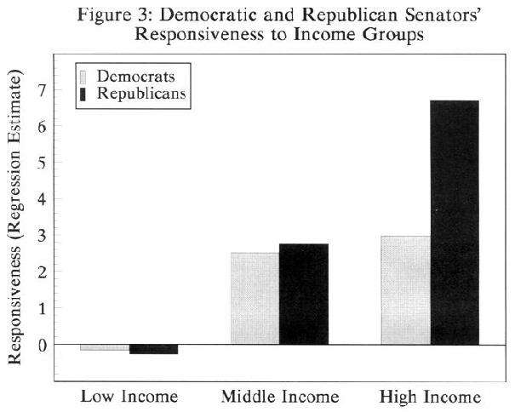
From a 2005 study by Larry M. Bartels
Notes:
1988-1992 data.

Slide 28
Current Issues
Debt
Finance
Wealth Concentration
Jobs (Employment)
Consumption and Production
Environment
Notes:
These all interrelate with each other and reinforce each other in very complex and frequently unanticipated ways.

Slide 29
Finance
Reckless provision of credit
Creation of dubious financial instruments
Collapse of housing and financial markets
Reluctance of lenders to lend
Reluctance of borrowers to borrow
These affect the concentration of wealth and employment prospects.
Notes:
Finance

Slide 30
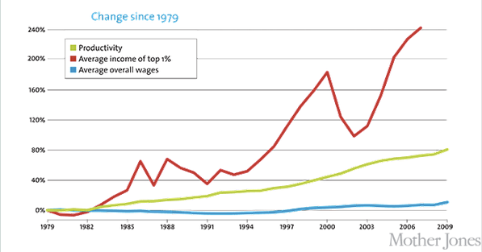
Changes in wages and productivity
Productivity has surged, but income and wages have stagnated for most Americans. If the median household income had kept pace with the economy since 1970, it would now be nearly $92,000, not $50,000.
Notes:
If the 1% of the red line was not included the blue line would show a downward slope. And this data is old. Note productivity goes up while wages go down.

Slide 31
Wealth Concentration
Along with economic power so also political power is concentrated.
We have witnessed great growth in profits without growth in wages
Erosion of fair and inclusive market rules
Capture of government for benefit of the few
Extractionism (Exploitation and exclusion of the poor)
Manipulations of Democracy
Erosion of opportunities for ownership and employment
Notes:
Wealth Concentration

Slide 32
Employment
Lower consumption means layoffs.
Leads to declining wages, skills, purchasing power.
This means lower consumption and therefore it impacts investment and production.
This is a vicious cycle (i.e. – Instability)
Notes:
Lower consumption means layoffs which means even lower consumption, etc.

Slide 33
The Triffin Dilemma
The use of a national currency (i.e. the U.S. dollar) as global reserve currency leads to a tension between national monetary policy and global monetary policy. This is reflected in fundamental imbalances in the balance of payments, specifically the current account: some goals require an overall flow of dollars out of the United States, while others require an overall flow of dollars into the United States.
Notes:
Robert Triffin 1911-1993

Slide 34
The Triffin Dilemma (source: IMF)
If the United States stopped running balance of payments deficits, the international community would lose its largest source of additions to reserves. The resulting shortage of liquidity could pull the world economy into a contractionary spiral, leading to instability.
If U.S. deficits continued, a steady stream of dollars would continue to fuel world economic growth. However, excessive U.S. deficits (dollar glut) would erode confidence in the value of the U.S. dollar. Without confidence in the dollar, it would no longer be accepted as the world's reserve currency. The fixed exchange rate system could break down, leading to instability.
Notes:
In 1971 Nixon closed the gold window thus killing the Bretton Woods System.

Slide 35
Mundell’s Trilemma
It is not possible to have monetary independence, free movement of capital, and stable currency exchange rates.
You must either let your currency float, or attempt to prevent currency from moving in or out of the country, or let someone else run your monetary policies.
Notes:
Robert Mundell born 1932 in Canada. He was one of the founders of Supply Side economics. Studied Canadian economic probs in the ‘60’s. His work became known in crises of the 80’s and 90’s and he was given the Nobel Mem. Prize in Economics 1999.

Slide 36
Recent Versions of Mundell’s Trilemma
Dani Rodrik’s version is that “democracy, national sovereignty, and global economic integration are mutually incompatible.”
Ashok Bardhan makes it a tettralemma. “It is difficult to see how tenuous co-habitation of these four – globalization, free market principles, democracy, and national policy independence – can survive in the present circumstances.”
Notes:
So assuming the European countries do not want to give up Democracy, they must either choose political integration or economic disintegration. Dani Rodrik teaches economics at Harvard. Ashok Bardhan is a Senior Research Associate at the Haas School of Business, UC Berkeley.

Slide 37
James Galbraith found weak correlations between political party and perceptions of equality
Those who perceive their world as roughly egalitarian tend to vote Republican.
Those who perceive it otherwise, tend to vote Democratic or not to vote at all.
Notes:
Galbraith’s Correlations. LBJ School of Public Affairs, U. of Texas, Austin.

Slide 38
Galbraithian Results
But Republican policies increase inequality.
While Democratic policies increase equality.
These are negative feedback loops which tend to produce a stable division of the country right down the middle.

Slide 39
More Galbraithian Results
Empirical studies show that Inequality in income leads to increased unemployment, which leads to increased inequality of income.
This is a vicious cycle leading to economic [and political] instability.
Galbraith’s book Inequality and Instability was published in 2012. But it is mostly a collection of articles previously published before 2008.
Notes:
e.g. – p.291 refers to studies by Harris-Todaro and Meidner-Rehn.

Slide 40
Wilkinson and Pickett
In The Spirit Level, Wilkinson & Pickett chart data that show societies that are more equal are healthier, happier societies.
They show that the relevant variable is not absolute wealth or income, but variation (inequality) of income within a nation.
What gets worse when rich and poor are too far apart? Health, lifespan, illiteracy, infant mortality, homicides, imprisonment, teenage births, obesity, mental illness, UNICEF index of child wellbeing, social mobility, even such basic values as trust.
And what is damaged is not just the outcome for the poor, but for everyone including the rich.
Notes:
Over 50 person-years of epidemiology. RW retired in 2008, published TSL in 2009.

Slide 41
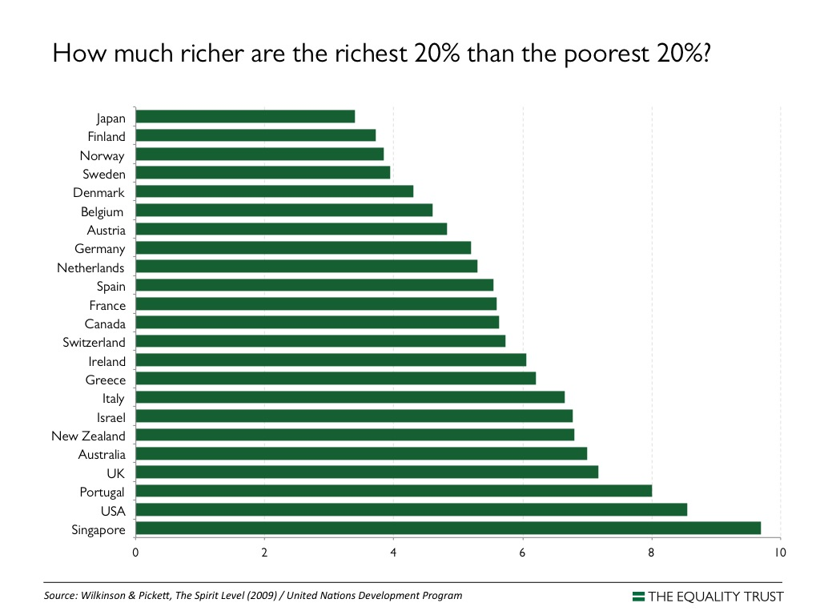
Notes:
This is way understated for wealth, must be income!

Slide 42
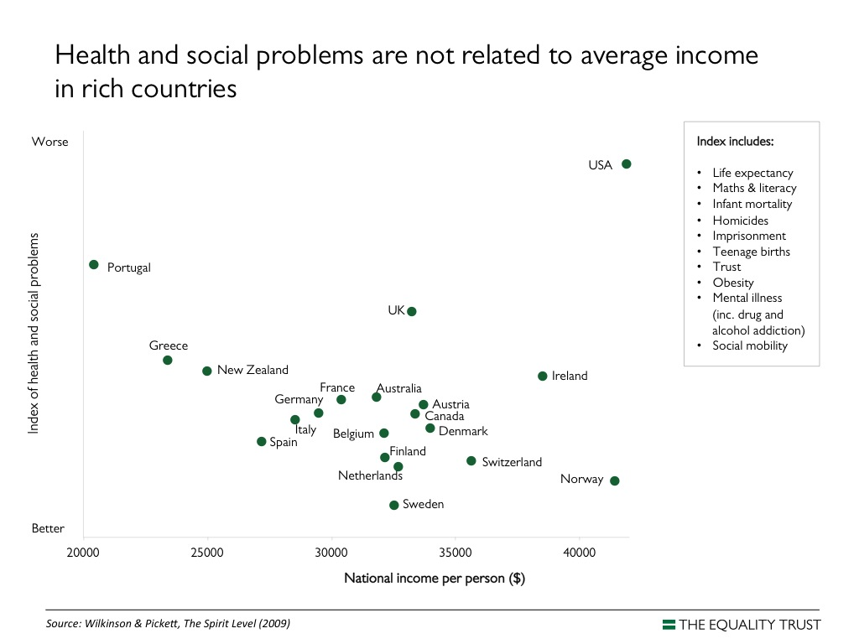

Slide 43
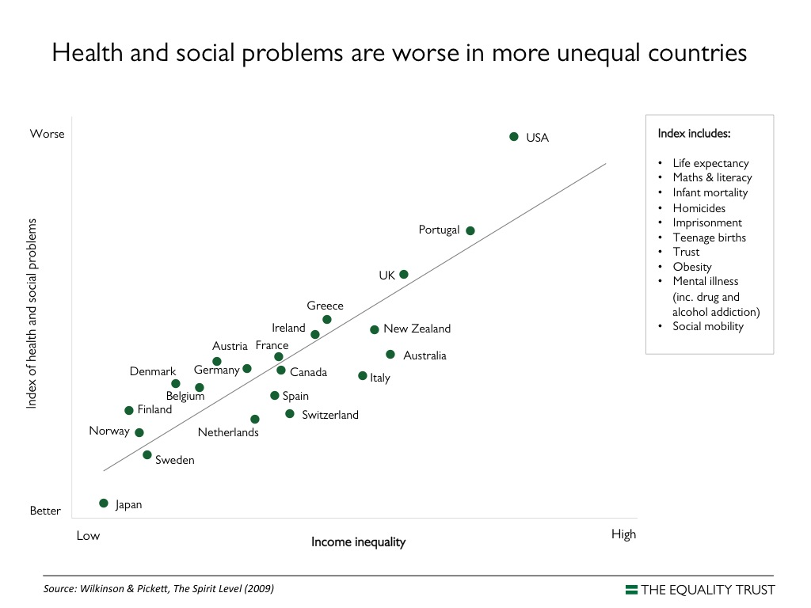

Slide 44
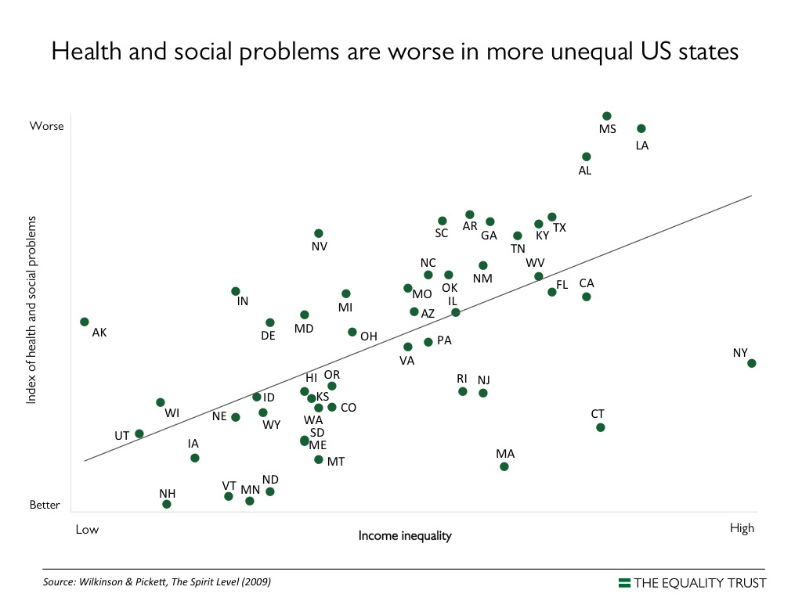

Slide 45
Death rates per 100,000 among working age men by social class of occupation.
England & Wales Sweden
1000
800
600
400
200
0
Unskilled
Professional
Notes:
Note that the lowest death rate in England is higher than the highest in Sweden. Similar studies with U.S. are even higher. The point is that greater equality is good for everyone, not just the poor. Data is old. Cf. pp. 175 – 182.

Slide 46
FDI & Outsourcing
Waste Fraud & Abuse
Offshore Bank Accounts
Hedge Funds & CurrencySpec
Notes:
Forex. In 2001 the Financial sector recorded a record of 46% of all corporate profits in the US (Huff Post, 3/30/11). Then a loss and now back to about 1/3rd.

Slide 47
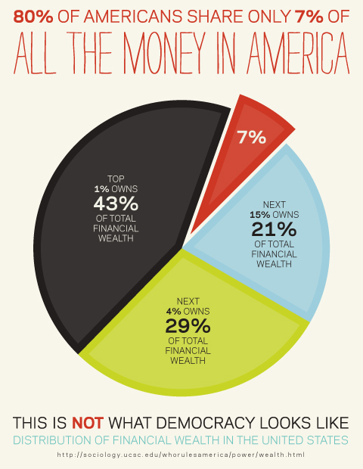
Notes:
This data reflects 2007 (before the chaos).

Slide 48
Financial (Non-Home) Wealth
(Source: E. N. Wolff@NYU)
 | Financial (Non-Home) Wealth
 | Top 1 percent |  | Next 19 percent |  | Bottom 80 percent
1983 | 42.9% |  | 48.4% |  | 8.7%
1989 | 46.9% |  | 46.5% |  | 6.6%
1992 | 45.6% |  | 46.7% |  | 7.7%
1995 | 47.2% |  | 45.9% |  | 7.0%
1998 | 47.3% |  | 43.6% |  | 9.1%
2001 | 39.7% |  | 51.5% |  | 8.7%
2004 | 42.2% |  | 50.3% |  | 7.5%
2007 | 42.7% |  | 50.3% |  | 7.0%
2010 | 42.1% |  | 53.5% |  | 4.7%
Notes:
Look at the bottom two lines.

Slide 49
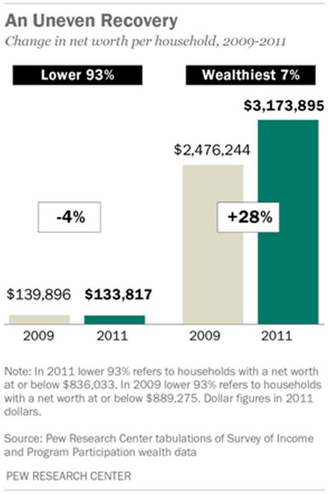
PEW Research: 2013
Notes:
This makes it even worse. (net worth here includes houses).

